Slide 2
What is Read Write Inc Phonics?
Read Write Inc. is a DfE validated phonics scheme designed by Ruth Miskin, which through systematic teaching and consistent routines, enables ALL children to achieve high levels of reading success.

Slide 3
What and When?
Daily phonics sessions with children grouped according to stage, not age.
Daily ‘Storybook’ sessions, everyone reads books that match the sounds they know in a group every day.
Reading books that match sounds children know are sent home to be read independently to consolidate learning.
Children can also take a ‘reading for pleasure’ book to be read with or by an adult to provide a broad and rich reading experience.

Slide 4
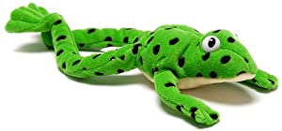
Planning:
All planning follows the sequence of sounds and blueprint lesson plans from Read Write Inc. and use common habits and routines that include:
Spotting special friends (identifying digraphs and trigraphs)
Fred Talk (saying the sounds individually out loud then blending the word)
Fred in your head (saying the sounds individually in your head)
Speedy Reading
Reading alien words
Spelling using Fred Fingers

Slide 5
Foundation
Working up to the model for spring term
Currently – baseline assessment
Stay in their class and taught by F2 team
10 -15 mins am – learning individual letter sounds and formation
Fred talk games
Picture book and book for pleasure and a RWI blending book

Slide 6
Assessment:
Each child is carefully assessed and placed into a RWI group based on their phonics sound knowledge and reading skills.
Your child might not be taught phonics by their own class teacher however all information and session notes are passed on from their RWI teacher to enable further guidance and support in all subsequent lessons.
Children are assessed each half term using Read Write Inc assessments. This ensures all pupils keep up and that gaps identified are re-taught in phonics sessions, 1:1 tutoring or in partnership with parents.
Any children who are not making sufficient progress will be given targeted intervention or additional 1:1 support.

Slide 7
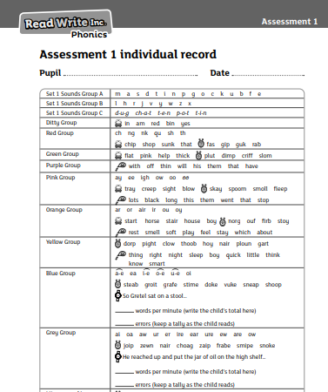
Units – Focus on vocabulary, inference, predict, finding and recording key details, summarising main ideas.

Slide 8
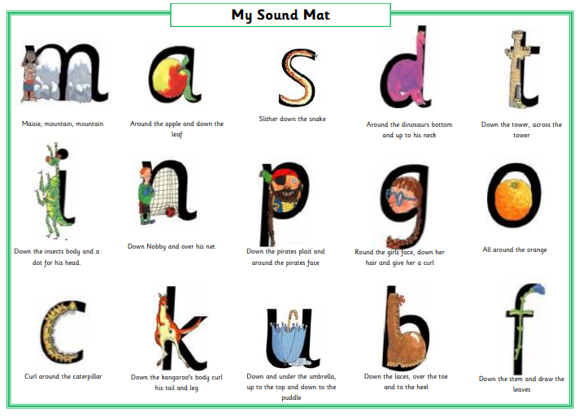
The Scheme: the children follow this progression whilst learning phonics.
Set 1

Slide 10
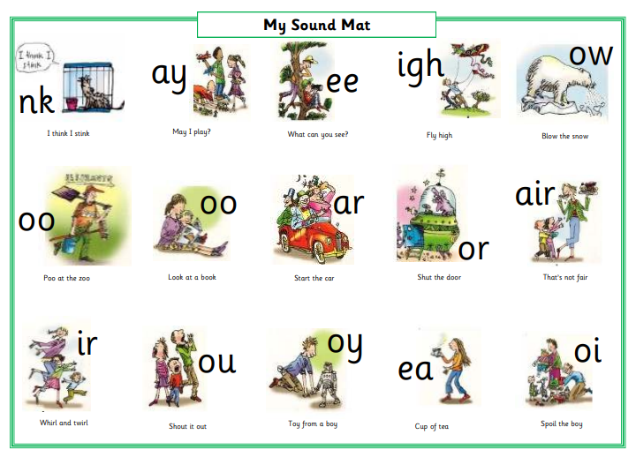
Set 2

Slide 11
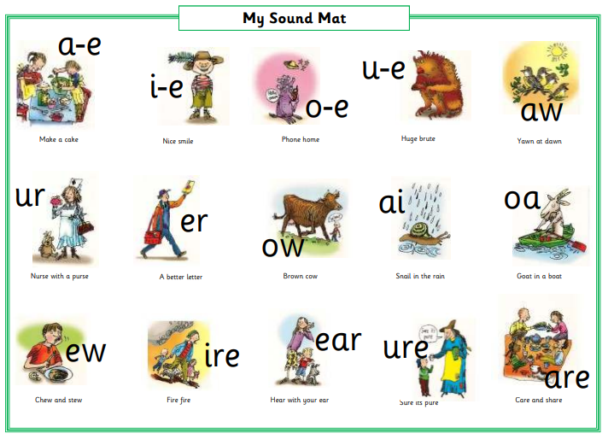
Set 3

Slide 12
Green words:
Fred Talk – segmenting and then blending to read.
Fred in your head – segment in their head and say the whole word.

Slide 13
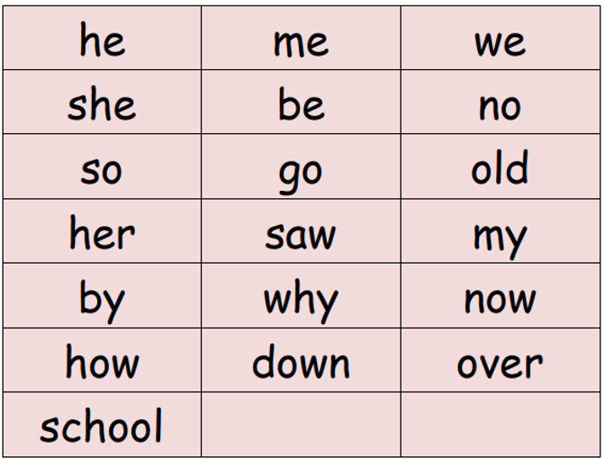
Red Words (Tricky Words)
Red words:
The children should be told these words and practise sight reading them (without blending – remember, you can’t Fred a red!).
Red Words (Tricky Words)
Red for a while words. These include graphemes that have not been taught by the time they are needed in the reading books.

Slide 14
Story books
The same book for the whole week – daily.
Recap on previously learned sounds, red words, new vocabulary and its meaning, paired reading, making predictions, echo reading to work on expression and answer comprehension questions.

Slide 15
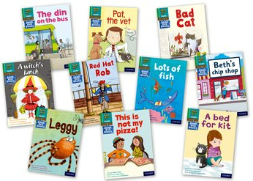
Reading Books to take home
‘Book Bag Books’ - these books are matched to the sounds they know and we ask that the books are read and re-read at least three times.
First read - focus on reading each word individually and it may seem robotic. In this phase very little comprehension of the story is likely.
Second read - word recognition will become quicker allowing a faster pace and better understanding of the story.
Third read - the speed should be much quicker and therefore the child is using more brain power to understand the story rather than on reading each word. This is the point when the story becomes meaningful and pleasurable and they can answer questions based on the content. There are questions at the end of the book to check understanding and promote discussion of the story.

Slide 16
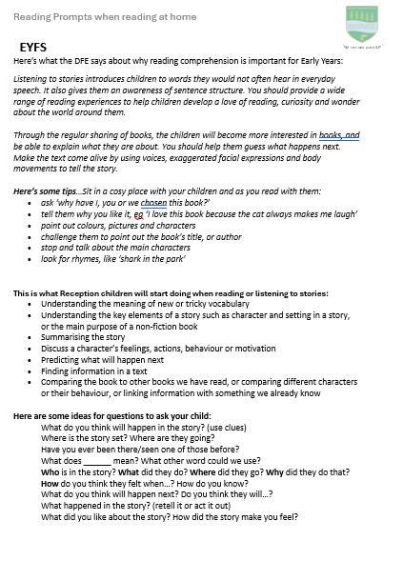
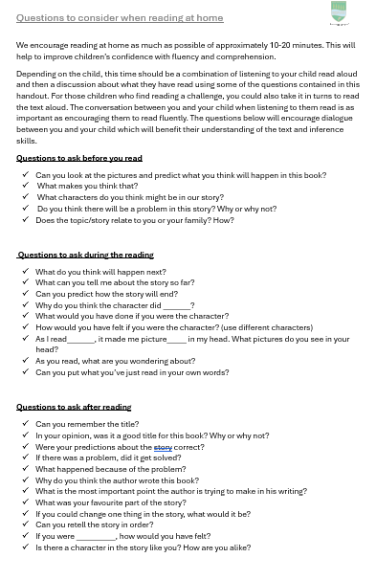
Support with reading at home

Slide 17
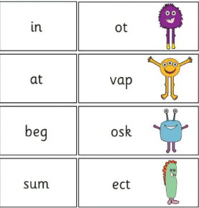
Phonics Screening
A test taken at the end of Year one
A list of 20 real words and 20 alien words
Pass mark 32/40

